Slide 1
CHAPTER 4
Number Theory and Cryptography
4.1 Divisibility and Modular Arithmetic可分割性和模块化算术
4.3 Primes and Greatest Common Divisors素数和最大公除数
4.4 Solving Congruences解决共轭的问题
1
Notes:
4.2 基数不要求
唯一做要求的是（整除，模运算，最大公倍数，公约数）

Slide 2
2. Division
【Definition】When a divides b we say that a is a factor (divisor)除数of b and that b is a multiple倍数of a.
Notations:
---- a 整除 b
---- a 不能整除 b.

Slide 3
基本性质

Slide 4
3. The Division Algorithm
【Theorem 2】Let a be an integer and d a positive integer.
Then there are unique integers q and r, with 0≤r<d such that
a = dq + r.
Note: d is the divisor除数
a is the dividend被除数
q is the quotient商
r is the remainder 余数(正)
〖Example 2〗 What are the quotient and remainder when −11 is divided by 3?
Solution:
−11 = 3 ⋅ (−4) + 1
− 11 div 3 = −4 and − 11 mod 3 = 1

Slide 5
4. Congruence Relation同余
Notation: a≡b(mod m)
Note: m is the modulus of the congruence a≡b(mod m)
【Theorem 4】Let m be a positive integer.
a ≡ b (mod m) iff there is an integer k
such that a = b + km.
【Theorem 5】Let m be a positive integer.
If a ≡ b (mod m) and c ≡ d (mod m),
then a + c ≡ b + d (mod m)
ac ≡ bd (mod m)

Slide 6
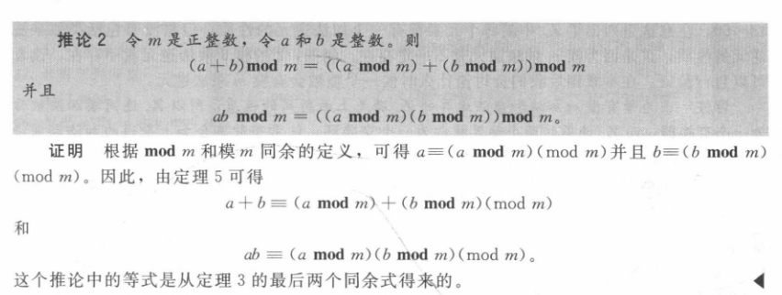
运算技巧

Slide 7
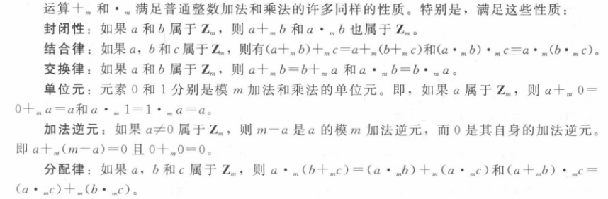
模算术
【Definition】Zm 为小于m的非负整数 {0, 1, …., m−1}, we can define two operations on Zm:
addition modulo m +_{m}
a +_{m} b = (a + b) mod m.
multiplication modulo m ∙_{m}
a ∙_{m} b = (a ∙ b) mod m.

Slide 8
【Theorem 1】算术基本定理
每个大于1的整数都可以唯一地写为两个或多个素数的
乘积，其中素数因子以非递减序排列
【Theorem 2】如果n是一个合数composite integer, 那么n必有一个
素因子小于等于
【Definition 1】A positive integer p greater than 1 is called prime素数 if the only positive factors of p are 1 and p.
A positive integer that is greater than 1 and is not prime is called composite 合数.

Slide 9
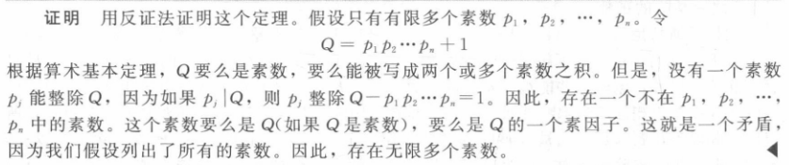
【Theorem 3】素数有无穷多
For example,
Show that 113 is prime.
Solution:
The primes not exceeding are 2,3,5,7.
Since 113 is not divisible by 2,3,5,or 7, it follows that 113 is prime.

Slide 10
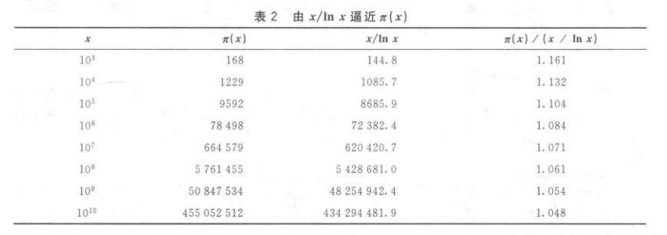
The distribution of primes
【Theorem 4】THE PRIME NUMBER THEOREM
当x无限增长时，不超过x的素数个数Π(x)与 x/ln x之比趋近于1

Slide 11
2. Greatest common divisor and least common multiple
【Definition 2】Let a and b be integers, not both zero. The largest integer d such that d∣a and d∣b is called the greatest common divisor最大公约数 of a and b .
Notation: gcd(a, b)
【Definition 3】最大公约数为1，则互素 relatively prime
【Definition 4】The integers a₁,a₂,…a_{n} are pairwise relatively prime if gcd(a_{i}, a_{j})=1 whenever 1≦i<j ≦n.

Slide 12
Problem: How to find gcd(a,b) ?
gcd(a,b) can be computed using the prime factorizations of a and b.
a = p₁^{a1} p₂^{a2} … p_{n}^{an}
b = p₁^{b1} p₂^{b2} … p_{n}^{bn}
gcd(a,b) = p₁^{min(a1,b1)} p₂^{min(a2,b2)} … p_{n}^{min(an,bn)}
〖Example 3〗 Find gcd(120,500).
Solution:
120 = 2³ ⋅ 3 ⋅ 5 = 2³ ⋅ 3¹ ⋅ 5¹
500 = 2² ⋅ 5³ = 2² ⋅ 3⁰ ⋅ 5³
gcd(120,500) = 2^{min(3,2)} ⋅ 3^{min(1,0)} ⋅ 5^{min(1,3)}
= 2² ⋅ 3⁰ ⋅ 5¹
= 20

Slide 13
【Definition 5】The least common multiple最小公倍数 of the positive integer a and b is the smallest integer that is divisible by both a and b.
Notation: lcm(a, b)
Problem: How to find lcm(a,b) ?
Suppose that the prime factorizations of a and b are as follows.
a = p₁^{a1} p₂^{a2} … p_{n}^{an}
b = p₁^{b1} p₂^{b2} … p_{n}^{bn}
lcm(a,b) = p₁^{max(a1,b1)} p₂^{max(a2,b2)} … p_{n}^{max(an,bn)}

Slide 14
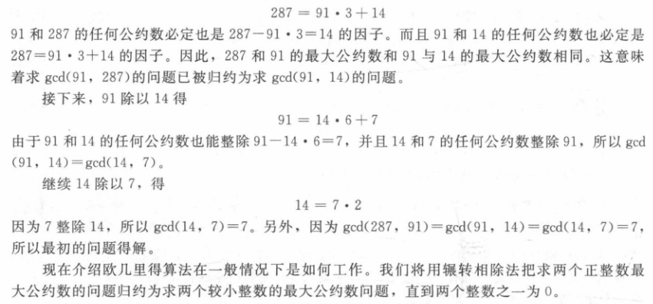
【Theorem 5】Let a and b be positive integers, Then
ab = gcd(a,b) ×lcm(a,b)

Slide 15
2. The Euclidean Algorithm欧几里德算法
【LEMMA 1】 Let a = bq + r, where a,b,q,r are integers.
Then gcd(a,b) = gcd(b,r).
Proof:
Show that the common divisors of a and b are the same as the common divisors of b and r.

Slide 16
Suppose that a and b are positive integers with a≥b.
Let r₀=a and r₁=b.
r₀ = r₁q₁ + r₂ 0≤r₂＜r₁,
r₁ = r₂q₂ + r₃ 0≤r₃＜r₂,
……
r_{n-2} = r_{n-1}q_{n-1} + r_{n} 0≤r_{n-1}＜r_{n,}
r_{n-1} = r_{n}q_{n .}
It follows from Lemma 1 that
gcd(a,b) = gcd(r₀ , r₁ ) = gcd(r₁ , r₂ )
= …… = gcd(r_{n-2} , r_{n-1} ) = gcd(r_{n-1} , r_{n} )
= gcd(r_{n} , 0 ) = r_{n}

Slide 17
ALGORITHM The Euclidean Algorithm.
Procedure gcd (a,b: 正整数)
x:=a
y:=b
while y≠0
begin
r:=x mod y
x:=y
y:=r
end {gcd(a,b) is x}

Slide 18
2. gcds as Linear Combinations gcd线性组合
【Bézout’s Theorem】贝组定理 Let a and b be positive integers, then
there exist integers s and t such that gcd(a,b) = sa + tb,
Note:
s and t : Bézout coefficients of a and b.
For example, gcd(6,14) = (−2)∙6 + 1∙14

Slide 19
For example, 这个方法叫做扩展欧几里得算法
express gcd(252,198) = 18 as a linear combination of 252 and 198.
Solution:反向
First use the Euclidean algorithm to show gcd(252,198) = 18
252 = 1∙198 + 54
198 = 3 ∙54 + 36
54 = 1 ∙36 + 18
36 = 2 ∙18
Now working backwards, from Ⅲ and Ⅱ above
18 = 54 − 1 ∙36
36 = 198 − 3 ∙54
Substituting the 2nd equation into the 1st yields:
18 = 54 − 1 ∙(198 − 3 ∙54 )= 4 ∙54 − 1 ∙198
Substituting 54 = 252 − 1 ∙198 (from Ⅰ)) yields:
18 = 4 ∙(252 − 1 ∙198) − 1 ∙198 = 4 ∙252 − 5 ∙198

Slide 20
3. Dividing Congruences by an Integer
【Theorem】Let m be a positive integer and let a, b, and c be integers.
If ac ≡ bc (mod m) and gcd(c,m) = 1, then a ≡ b (mod m).

Slide 21
Linear Congruences
【Definition】A congruence of the form ax ≡ b( mod m),
where m is a positive integer, a and b are integers, and x is a variable, is called
a linear congruence线性同余方程
【Definition】An integer ā such that āa ≡ 1( mod m) is said to be an inverse逆 of a modulo m.（可以证明存在且唯一）
Example:
5 is an inverse of 3 modulo 7 since 5∙3 = 15 ≡ 1(mod 7)

Slide 22
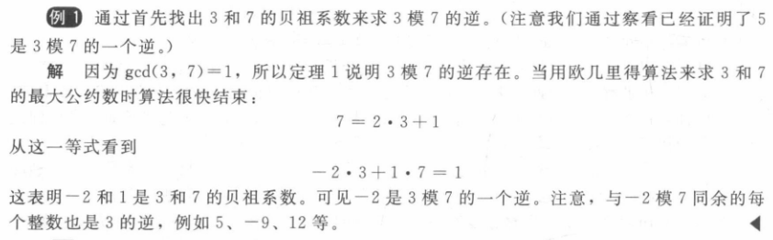

Slide 23
Example: Find an inverse of 101 modulo 4620.
Solution:
First use the Euclidian algorithm to show that gcd(101,4620) = 1.
4620 = 45∙101 + 75
101 = 1∙75 + 26
75 = 2∙26 + 23
26 = 1∙23 + 3
23 = 7∙3 + 2
3 = 1∙2 + 1
2 = 2∙1
Working Backwards:
1 = 3 − 1∙2
1 = 3 − 1∙(23 − 7∙3) = − 1 ∙23 + 8∙3
1 = −1∙23 + 8∙(26 − 1∙23) = 8∙26 − 9 ∙23
1 = 8∙26 − 9 ∙(75 − 2∙26 )= 26∙26 − 9 ∙75
1 = 26∙(101 − 1∙75) − 9 ∙75
= 26∙101 − 35 ∙75
1 = 26∙101 − 35 ∙(4620 − 45∙101)
= − 35 ∙4620 + 1601∙101
Since the last nonzero remainder is 1, gcd(101,4620) = 1
Bézout coefficients :
− 35 and 1601
1601 is an inverse of 101 modulo 4620

Slide 24
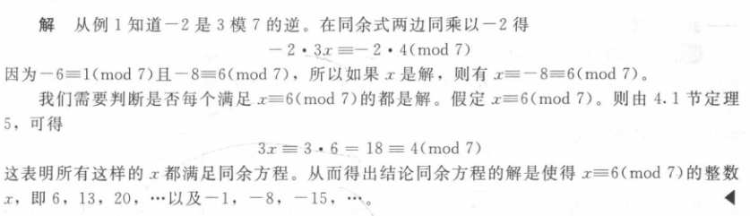
Using Inverses to Solve Congruences
6 + 7k

Slide 25
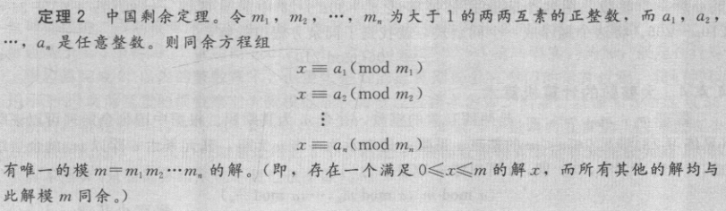
The Chinese Remainder Theorem 中国剩余定理

Slide 26
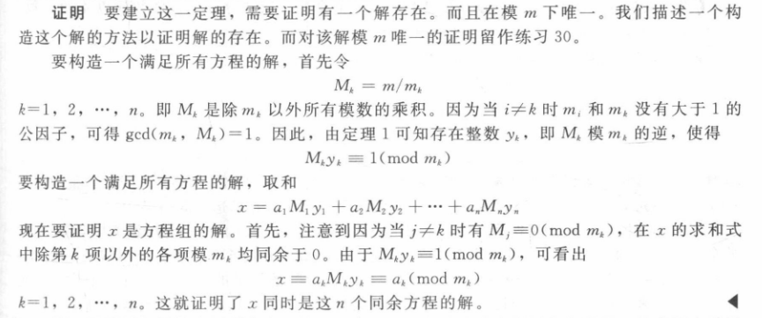
The Chinese Remainder Theorem

Slide 27
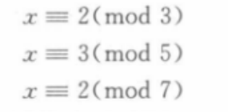
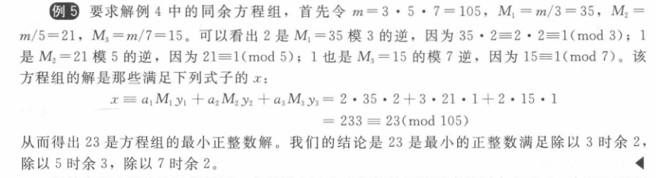
The Chinese Remainder Theorem
但是后面的反向替换法会更方便一些

Slide 28
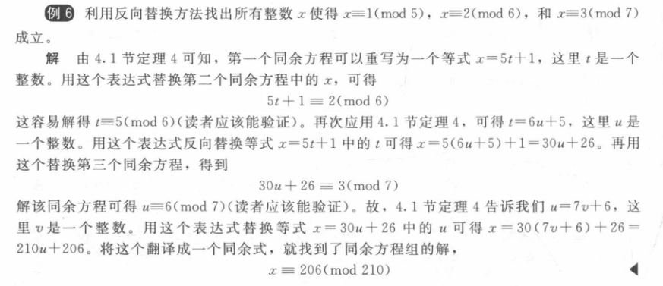
Back Substitution 反向替换法

Slide 29
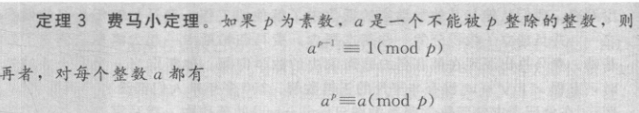
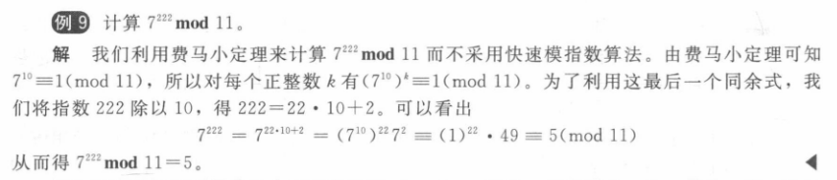
2023必考，重点掌握

